Slide 1
Rational Numbers as Decimals

Slide 2
Rational Numbers
Positive & Negative Rational Numbers
Standard & Absolute value
Rational Number on a Number line
Operation on rational numbers.
Conversion of Fraction to Decimals
Rational Numbers as Decimals
Terminating Decimals & Non-terminating Decimals
Conversion of Decimals into Rational Numbers
Addition and subtraction of Decimal Numbers
Multiplication and Division of Decimal Numbers

Slide 3
LETS REWIND OUR KNOWLEDGE

Slide 4
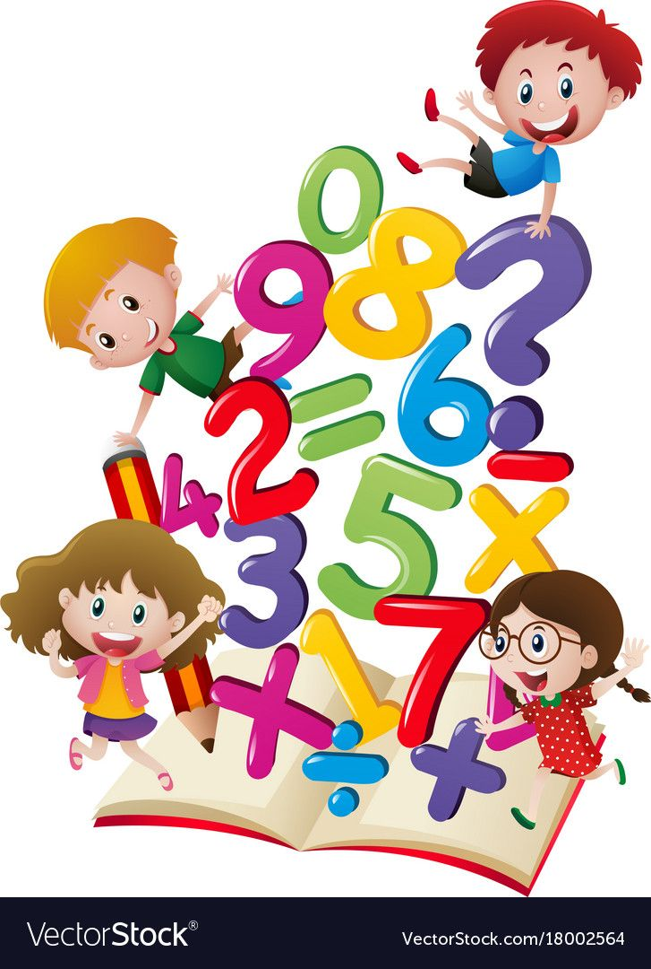
Number System includes…..
Natural numbers :- The numbers which we use for counting are called Natural numbers.
Example :- 1,2,3,4,…….
Whole numbers:- Natural numbers along with zero forms the Whole numbers.
Examples:- 0,1,2,3,4,5……..
Integers :- A collection of natural numbers ,negative numbers along with zero is called an Integers.
It is denoted as Z.
Examples:- 0,1,2,-1,-2,3,-3 etc

Slide 5
Introduction

Slide 6
RATIONAL NUMBERS
The numbers which can be expressed in the form p/q where p and q are integers and q ≠ 0 are known as Rational Numbers.
For example : -
Thus, we can say that positive integers, negative integers, zero and common fractions together constitute to form the new system of Rational Numbers.
The set of Rational numbers is infinite
&
is denoted by Q

Slide 7
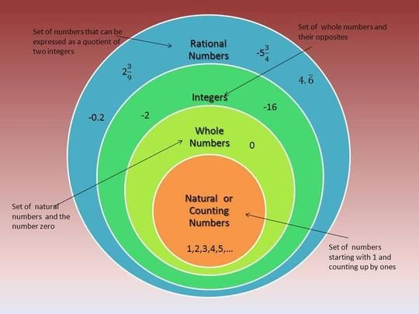
Venn Diagram

Slide 8
NUMBER SPRINKLE
ACTIVITY
First 'Sprinkle" the numbers on the ice cream scoops in order to classify rational numbers, whole numbers, integers, and natural numbers. Then colour each type of number "Flavour" by referring to the "Flavours'" box.
Natural No.
Whole No.
0
1 2 3 15 10 5/6 3
.009 1.76 3/2 p/q 3.12 -1 -3 -2/17 -2
Integers
Rational Numbers
This cone holds the Real Number system
Ice Cream Flavours
Natural : Vanilla
Whole No. : Mint
Integers :Pinky Cotton candy
Rational No.: Blue Dart
Any color to cone.

Slide 9
POSITIVE RATIONAL NUMBERS
If the numerator and denominator of a rational number have the same sign, it is called a POSITIVE RATIONAL NUMBER.
For Example : -

Slide 10
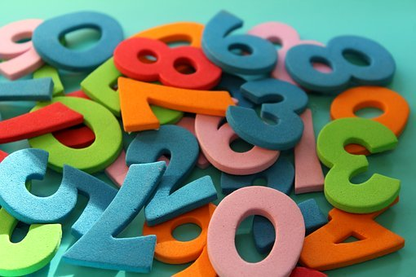
NEGATIVE RATIONAL NUMBERS
If the numerator and denominator of a rational number have the opposite signs, it is called a NEGATIVE RATIONAL NUMBER.
For Example : -

Slide 11
STANDARD FORM
Every rational number p/q can be put in the simplest form with positive denominator. This form of the rational number is called its Standard Form.
For this, we take the following steps.
Step 1. Make the denominator positive.
Step 2. Find the HCF m of p and q. If m = 1, then p/q is the required form.
Step 3. If m ≠ 1, then divide both the numerator and the denominator by m. The rational number p ÷ m /q ÷ m so obtained is the required Standard Form.

Slide 12
ABSOLUTE VALUE OF A RATIONAL NUMBER
Absolute value of an Rational Number is its numerical value without taking the sign into account.
e.g. | – 3/5 | = 3/5, | - 3 | = 3, | 0 | = 0

Slide 13
Representation of Rational Number on a Number Line

Slide 14
WHY IS BASEBALL LIKE CAKE ?
RIDDLE
Simplify each problem below completely and match your solution at the bottom of the page. Write letter of that problem in the box given below in order to solve the Riddle, Some letter may be unused.
A | |-13|
B | |23|
C | - |- 6 |
D | | |
E
N
I | |25|
K
L | |7| - |-5|
N | |15.2 – 8.1|
O | |-1| + |-14|
R
S | |- 13| - |8.5|
T | |2.16| - |0.88|
W
Y

Slide 15
Comparison of Rational Numbers
Rational numbers can be compared in two different ways
By representing on number line.
Without representing on number line.
We have the following facts about the comparison of rational numbers.
Every positive rational number is greater than zero.
Every negative rational number is less than zero.
Every positive rational number is greater than every negative rational number.
Every rational number represented by a point on the right of number line is greater than every rational number represented by points on its left.
Every rational number represented by a point on the left of number line is less than every rational number represented by points on its right.
If two rational numbers have the same positive denominator, the number with the larger numerator will be greater than the one with smaller numerator.
If two rational numbers have different denominators, then first make denominators equal and then compare.

Slide 16
For example:-
Which of the two rational numbers -4/9 and 5/-12 is greater?
Soln. First we write each of the given rational numbers with positive denominator.
Clearly, denominator of -4/9 is positive. The denominator of 5/-12 is negative. So we express it with positive denominator as follows.
5/-12 = 5x(-1)/(-12)x(-1) = -5/12.
Now, LCM of denominators 9 and 12 is 36. We write the rational numbers so that they have a common denominator 36 as follows.
-4/9 = -4x4/9x4 = -16/36 and -5/12 = -5x3/12x3 = -15/36
؞ -15 > -16 = -15/36 > -16/36 = -5/12 > -4/9 = 5/-12 > -4/9

Slide 17
Addition of Rational numbers
A rational number is a ratio of two numbers p and q, where q is non-zero number. Here p is called the numerator and q is called the denominator. When it comes to addition of two such rational numbers, there can be four possible variations.
First, both the rational numbers could have the same denominator.
For example, when we wish to add 3/5 and 1/5, the answer is simply the sum of 3 and 1, divided by the common denominator 5. So
Addition of numerators
Common denominator
Add numerators of the rational numbers and then divide by the common denominator

Slide 18
Addition of Rational numbers
When the two rational numbers are added having different denominators.
Like we have seen earlier, we will make the two numbers similar to each other by taking the lowest common multiple of both denominators.
So, to add 5/6 and 7/9,, we first need to find the LCM of 6 and 9, which is 18.
So, we can write 5/6 as 15/18 and 7/9 as 14/18.
Then the addition of these two rational numbers can be expressed in the following way

Slide 19
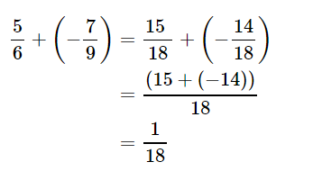
Addition of Rational numbers
When one of the two rational numbers which are added with different denominators is negative.
For example:- If we need to add 5/6 and −7/9, then the addition can be carried out in the following manner

Slide 20
Properties of addition of rational numbers
Property-1 :- When two rational number is added the sum remains the same even if we change the order of the addends.
For two rational numbers x and y,
x + y = y + x.
This is called as COMMUTATIVE LAW OF ADDITION.
Property – 2 :-
Sum of three rational numbers remains the same even after changing the grouping of the addends, i.e.
if x, y and z are three rational numbers, then
(x + y) + z = x + ( y + z )
This is knows as ASSOSIATIVE LAW OF ADDITION.

Slide 21
Property – 3
When zero is added to any rational number, the sum is the rational number itself, i.e.
if x is a rational number, then
0 + x = x + 0 = x.
Zero is called the identity element of addition.
Property – 4
Every rational number has an additive inverse such that their sum is equal to zero.
If x is a rational number , then – x is a rational number such that
x + ( - x) = 0
-x is called as the additive inverse of x.
It is also called the negative of x.

Slide 22
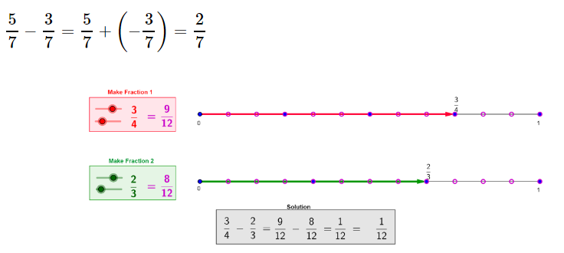
Subtraction of Rational numbers
Now let us see
How to subtract 3/7 from 5/7.
The additive inverse of 3/7 is −3/7.
So, the subtraction can be expressed as the addition to additive inverse.

Slide 23
Properties of subtraction of rational numbers
Property – 1 :
For rational numbers x and y, x – y ≠ y – x in general. In fact, x – y = – (y – x), i.e. commutative property does not hold true for subtraction.
Property – 2 :
For rational numbers x, y, z, in general, (x – y) – z ≠ x – (y – z), i.e. the associative property does not hold true for subtraction.
Property 3:
Identity element for subtraction does not exist.
Property 4:
Since the identity element for subtraction does not exist, the question for finding inverse for subtraction does not arise.

Slide 24
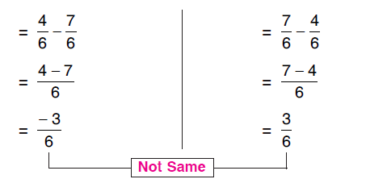
Examples to illustrate these properties

Slide 25
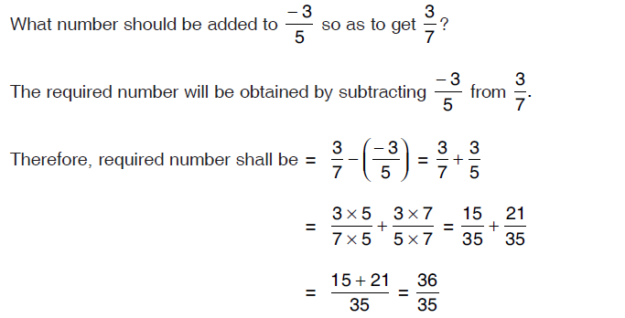
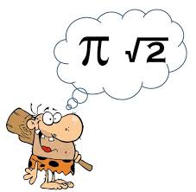
Some more examples

Slide 26
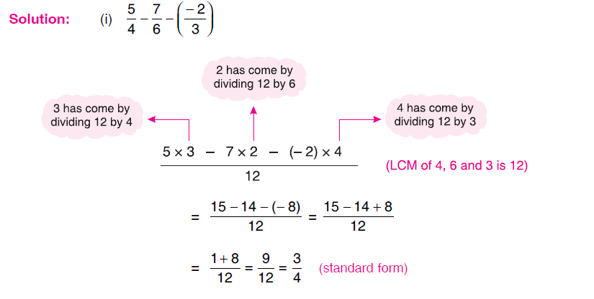
Solution =

Slide 27
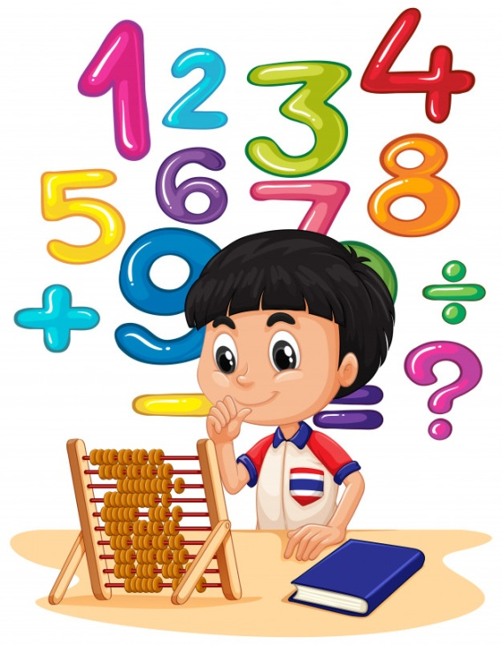
Multiplication of rational numbers

Slide 28
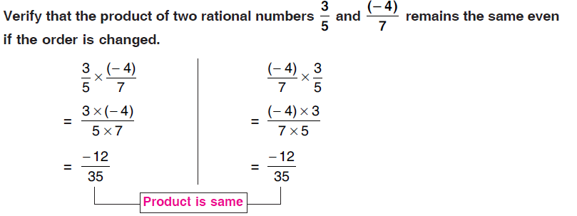
PROPERTIES OF MULTIPLICATION OF RATIONAL NUMBERS
Property – 1 :-
Product of two rational numbers remains the same even if we change their order,
i.e. if x and y are rational numbers, then
x × y = y × x.
This is known as commutative law of multiplication.

Slide 29
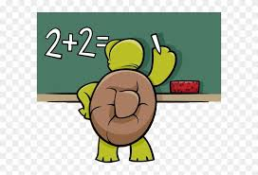

Slide 30
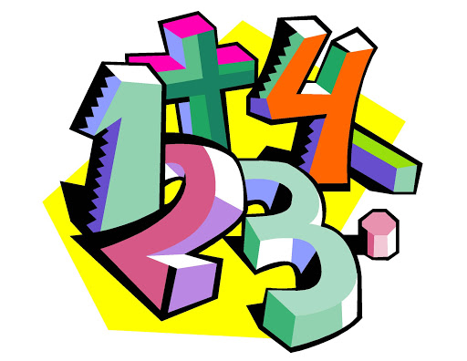
Property – 2:- Product of two rational number remains the same even when we change the grouping of rational numbers,
i.e. if x , y and z are rational numbers, then
( x × y ) × z = x × ( y × z)
This is called as associative law of multiplication.
Property-3:-
Product of a rational number and zero is zero,
i.e. if x is any rational number, then
x × 0 = 0 × x = 0

Slide 31
Property-4:-
One multiplied by any rational number is the number itself.
i.e. if x is a rational number,
then x × 1 = 1 × x = x
i.e. 1 is an identity element under multiplication
Property – 5:-
If x, y and z are rational numbers, then
x × (y + z) = x × y + x × z
x × (y – z) = x × y – x × z
This is distributive law of multiplication over addition.

Slide 32
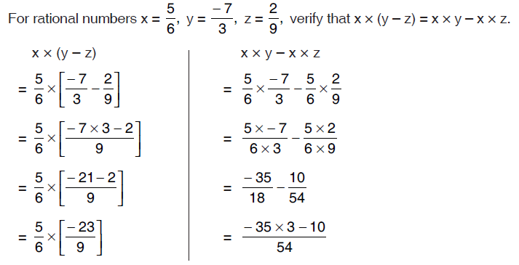
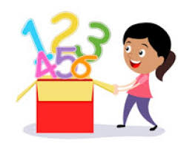

Slide 33
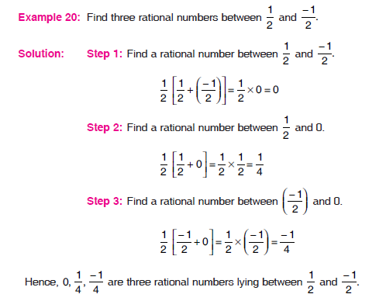
Rational between two rational numbers
Between any two rational numbers, there are infinitely many rational numbers.

Slide 34
Conversion of Fraction to Decimals
0.1
0.3
0.23
Any fraction having denominator as 10 or a power of 10 (i.e. 10, 100, 1000,…) can be easily represented in decimal form.

Slide 35
How to represent a Rational number in Decimal form , if the denominator is not 10,100,1000?????

Slide 36
Rational Numbers as Decimals
Rational numbers can be represented in decimal forms rather than representing in fractions. They can easily be represented as decimals by simply converting the denominator to 10,100, 1000 or a power of 10.
For example,
Oh!
I got it.

Slide 37
A Rational Number can have two types of decimal representations (expansions):
Rational numbers
Non-terminating
Repeating
Non- repeating
Terminating

Slide 38
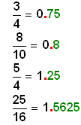
Terminating Decimals
Terminating decimals are those numbers which come to an end after few repetitions after decimal point. In the long division we get zero as the remainder and the quotient has a finite number of decimal places.
Example: 0.5, 2.456, 123.456, etc. are all examples of terminating decimals.
Here, the decimal expansion of 1/16 terminates after 4 digits.
Decimal Representation terminates after 4 digits
✍Note: In terminating decimal expansion, you will find that the Prime Factorisation of denominator has no other factors than 2 and 5.

Slide 39
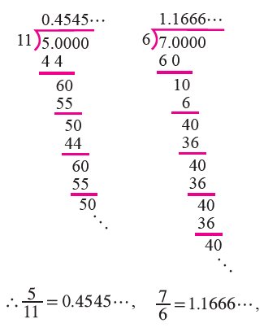
Non – Terminating but repeating
The non-terminating but repeating decimal expansion means that although the decimal representation has an infinite number of digits, there is a repetitive pattern to it.
For example:
Decimal Point
First Repeating Pattern
Decimal Point
First Repeating Pattern

Slide 40
CONVERSION OF TERMINATING DECIMALS INTO RATIONAL NUMBERS
Count the number of decimal places.
Write the given number without the decimal point,
Write the number as the numerator.
The denominator is one followed by as many zeroes as is the number of decimal.

Slide 41
For Example
Convert 2.25 in the form p/q .
Solution:
Count the number of decimal places. In this case it is two.
Write the given number without the decimal point, i.e. 225.
Write a number with 225 in the numerator.
The denominator is one followed by as many zeroes as is the number of decimal places in the given number.In this case, the denominator will be 100.
Therefore, the required number is 225/100.
Therefore, 2.25 = 225/100 = 9/4 (in lowest form)

Slide 42
OPERATIONS ON DECIMAL NUMBERS

Slide 43
Addition

Slide 44
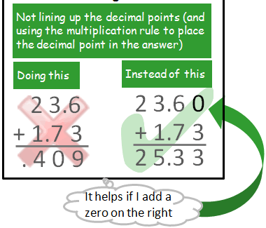
Common error when adding decimals

Slide 45
Subtraction

Slide 46
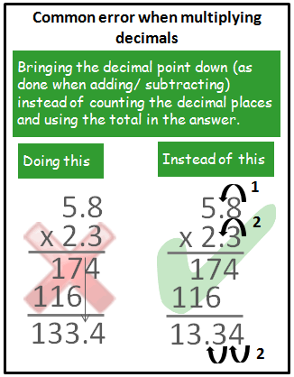
Common error when multiplying decimals

Slide 47
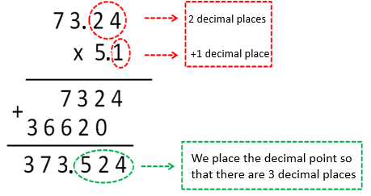
Multiplication

Slide 48
Multiplication of Decimals is fun…
ACTIVITY
Try yourself …….
0.3 x 0.5 ; 5 x 0.6

Slide 49
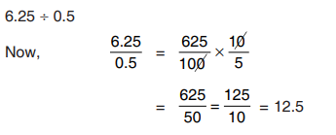
Divide Decimals
Method - 1
Method - 2

Slide 50
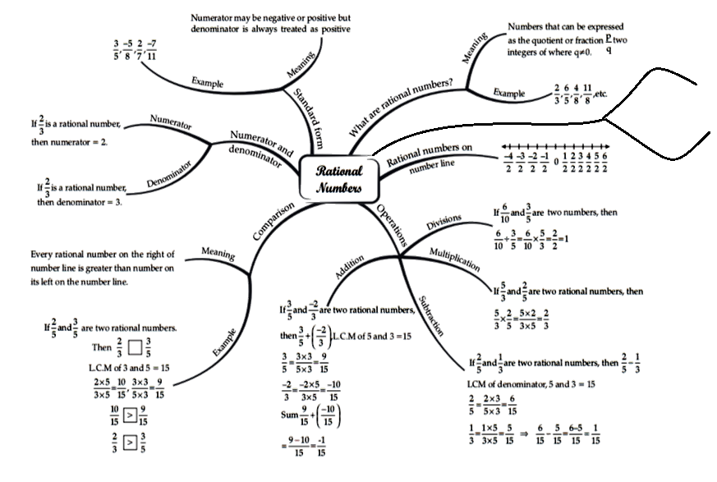
Mind Mapping
Terminating Decimals
As Decimals
Non-terminating Decimals

